Slide 1
Java Workshop 12 – Advanced Concepts
This workshop will advance your knowledge on various concepts
Ben Schwarz

Slide 2
Lesson Outline
Inner Classes:
Inner Classes a.k.a member classes
Static Inner Classes
Anonymous Inner Classes
Java Annotations
Functional Interfaces
Recursion
Ternary Operators

Slide 3
Inner Classes
There are three types of inner classes:
Inner classes (Member classes)
Static Nested Classes
Anonymous Inner Classes

Slide 4
1. Inner Classes - Member class (non-static)
In a class you can declare various types of objects and methods, but you can also declare classes.

Slide 5
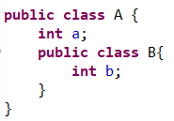
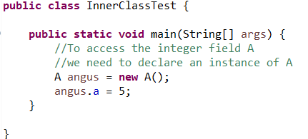
Take these 2 classes
Class A
Main

Slide 6
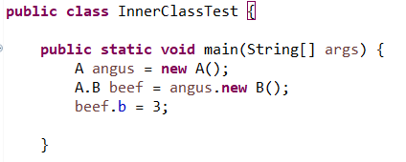
Likewise to access B
Class A
Main

Slide 7
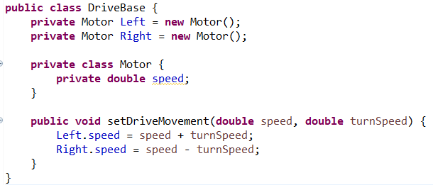
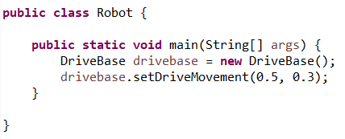
Inner Classes can also be Private or Protected
Drivebase
Robot

Slide 8
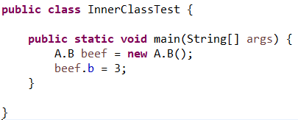
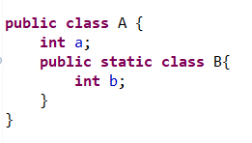
2. Static Inner Class
Advantage: Don’t need an object of A to create an instance of B
Class A
Main

Slide 9
Exercises
Inside your main class, create a static class car with the fields String colour and String name. It should also have a void method driveBy with prints “VOOM!” to the console. In your main method, create two of these vehicles, and call the driveBy method.
Create a class Cartesian Plane:
Create an inner-class Point with 2 private fields double x and double y (with getters and setters)
Create a constructor which takes in a value for x and a value for y and assigns accordingly.
Create a double method getDistance which takes in two Points and returns their distance.
Create a class Math – with a main method, and in it create two points. Then print out their distance using the getDistance method from Cartesian Plane.

Slide 10
Anonymous Inner Classes
What if I wanted to define the characteristics of a class when I create an instance of it?

Slide 11
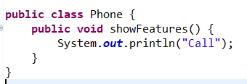
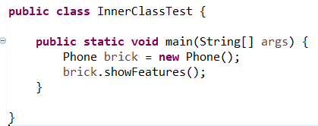
I have a phone
Phone
Main

Slide 12
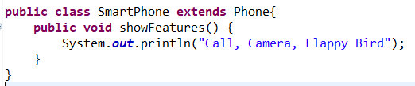
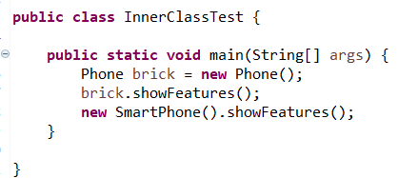
If I want to override this display method for my fancy SmartPhone, I would need to create a whole new class.
SmartPhone
Main

Slide 13
However this means every time I want to modify this I have to create a new subclass

Slide 14
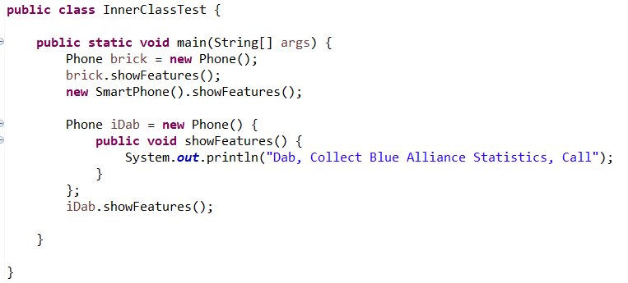
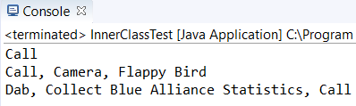
Anonymous Inner Class

Slide 15
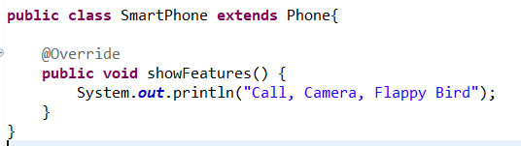
Java Annotations
A Java annotation tells your computer something about your code.
Java Annotations are optional.
However Annotations are often useful as they can serve as useful reminders about what certain code does.
That being said, some annotations are less optional than others – requiring large amounts of unannotated Java code if removed.

Slide 16
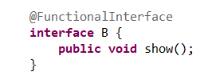
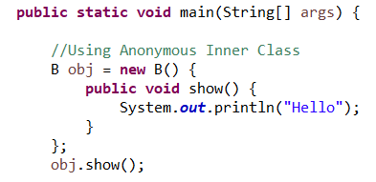
Functional Interfaces
A functional interface is an interface that contains only one abstract method.
They can exhibit only one method.

Slide 17
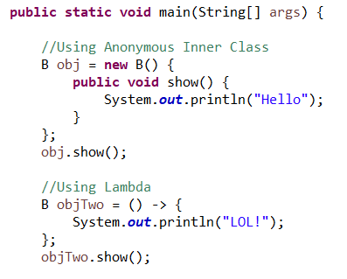
Lambda
Lambdas allow to do the same job as an anonymous inner class when using a functional interface, but with far less code.
Lambdas also provide a means to pass a method like a variable
*It is also more efficient in the sense that it doesn’t create a new file when compiled.

Slide 18
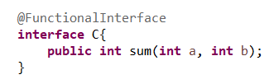

Lambda Summing Two Numbers

Slide 19
Usage in Robot Code:

Slide 20

Exercises:
Create a functional interface with a method twoNumbers (double a, double b).
Then using lambdas create a sum variation, a multiply variation and a divide variation.
Use all 3 variations for the following test cases:
5 and 3
23.8 and 6
436 and -6
4613 and 3.41
Repeat the multiply variation, but instead using an anonymous inner class
The end result should look like the following:

Slide 21
Recursion
Recursion is a programming technique in which a method calls itself in order to solve a problem.
Some problems can only be solved through recursion, and some are best solved through recursion.

Slide 22
The Classic Factorial Example
The factorial of any given interger – n, is the product of all the integers from 1 to n.
Therefore the factorial of 5 is 120: 5x4x3x2x1.
On your calculator the factorial button has the sign !

Slide 23
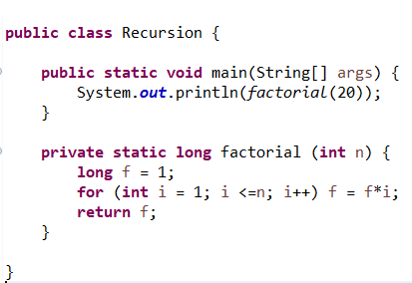
The Non-Recursive Solution

Slide 24
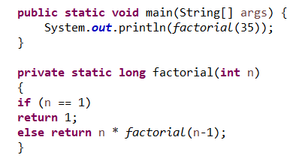
The Recursion Solution
Note: The function contains an ending condition. Failure to do so would mean the program will run forever.

Slide 25

Ternary Operators
The ternary operator is a way to do a short hand form of the if statement.
booleanExpression ? expression1 : expression2
These can often make code hard to read. Usually an if-else statement makes for a better choice.

Slide 26
Lesson Summary:
You should now know how to use:
Inner Classes:
Inner Classes a.k.a member classes
Static Inner Classes
Anonymous Inner Classes
Java Annotations
Functional Interfaces
Recursion
Ternary Operators

